Slide 1
Presentation Chapter 1-4
Group 1
Chan, Chi Ian
Fang, Jian Jun

Slide 2

Notation
r denotes the position vector of a particle in $ℝ3$
r $≔$ |r|
v $≔$ $\dot{r}$ $≔ \frac{dr}{dt}$, a $≔\ddot{r}≔ \frac{d^{2}r}{dt^{2}}$

Slide 3
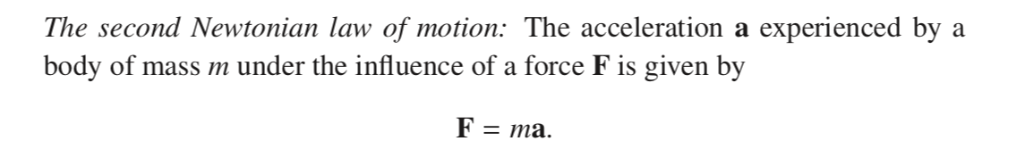
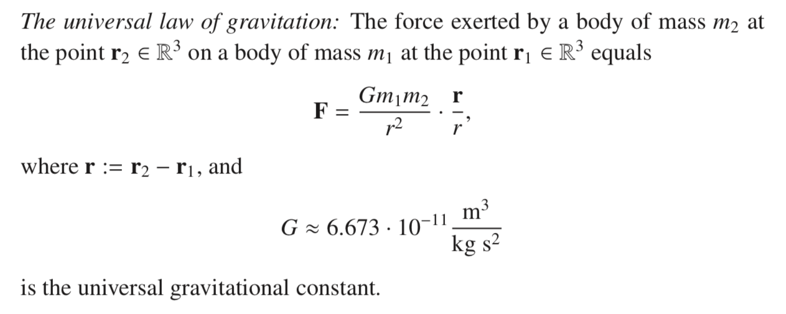
Physical Background

Slide 4
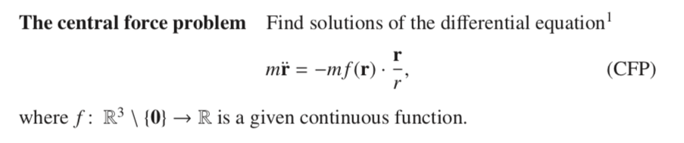
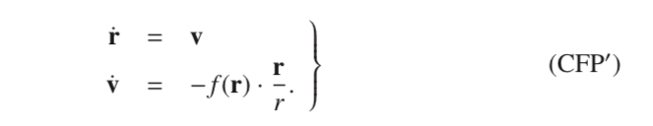




The central force problem
$r:I→ℝ^{3}\backslash \left\{0\right\}, I⊂ℝ$
$$t↦r\left(t+b\right),b∈ℝ$$
$$t↦r(−t)$$

Slide 5
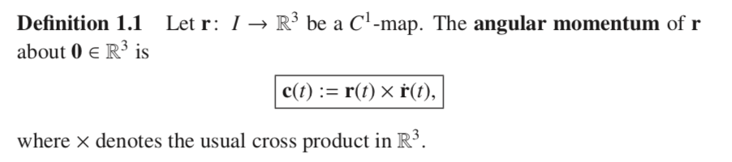
Angular momentum
Angular momentum of per unit mass

Slide 6
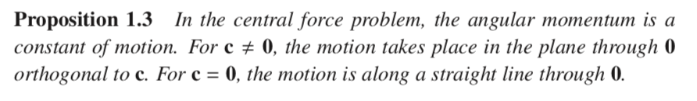
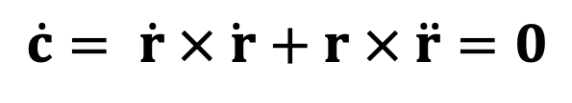

Angular momentum
For c ≠ 0,
$$\dot{c}= \dot{r} ×\dot{ r}+r × \ddot{r}=0$$
$$\left\langle c,r\right\rangle =0$$
= 0 by CFP
orthogonal by defintion

Slide 7
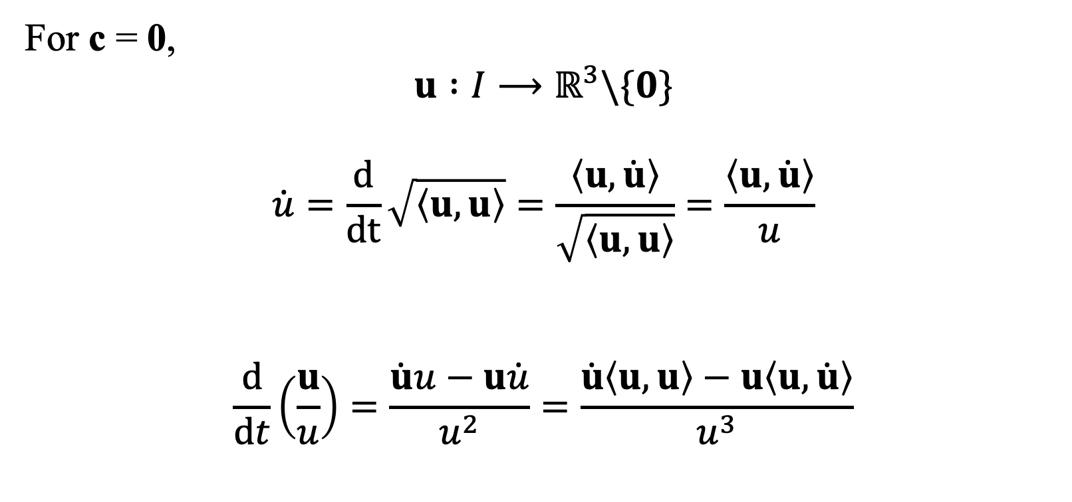
Angular momentum
For c = 0,
$$u :I⟶ℝ^{3}\backslash \{0\}$$
$$\dot{u}=\frac{d}{dt}\sqrt{\left\langle u, u\right\rangle }=\frac{\left\langle u, \dot{u}\right\rangle }{\sqrt{\left\langle u, u\right\rangle }}=\frac{\left\langle u,\dot{u}\right\rangle }{u}$$
$$\frac{d}{dt}\left(\frac{u}{u}\right)=\frac{\dot{u}u−u\dot{u}}{u^{2}}=\frac{\dot{u}\left\langle u,u\right\rangle −u\left\langle u,\dot{u}\right\rangle }{u^{3}}$$

Slide 8
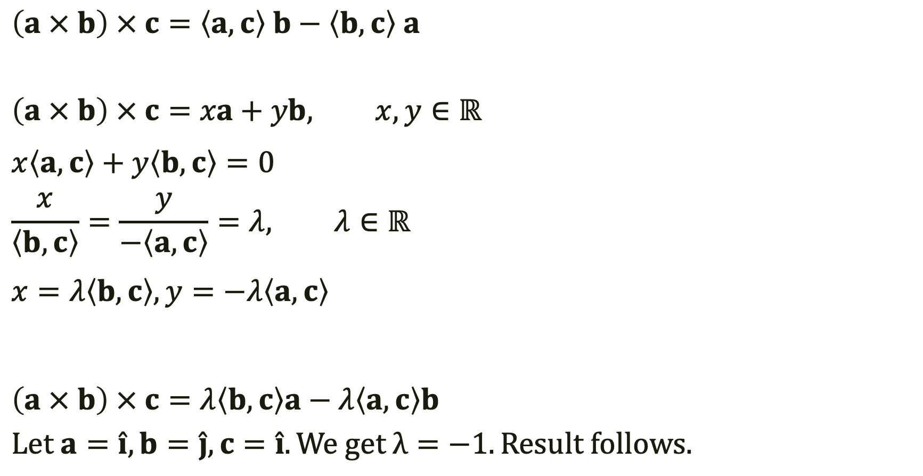
Graßmann identity
$$\left(a × b\right) × c=\left\langle a,c\right\rangle b−\left\langle b, c\right\rangle a$$
$$\left(a × b\right) × c=xa+yb, x,y∈ℝ$$
$$x\left\langle a,c\right\rangle +y\left\langle b,c\right\rangle =0$$
$$\frac{x}{\left\langle b,c\right\rangle }=\frac{y}{−\left\langle a,c\right\rangle }=λ, λ∈ℝ$$
$$x=λ\left\langle b,c\right\rangle , y=−λ\left\langle a,c\right\rangle$$
$$\left(a × b\right) × c=λ\left\langle b,c\right\rangle a−λ\left\langle a,c\right\rangle b$$
$$Let a=\hat{i}, b=\hat{j}, c=\hat{i}. We get λ=−1. Result follows.$$

Slide 9
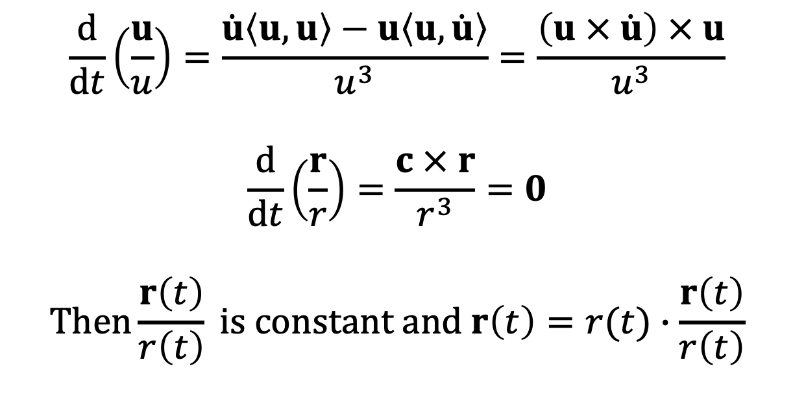
Angular momentum
$$\frac{d}{dt}\left(\frac{u}{u}\right)=\frac{\dot{u}\left\langle u,u\right\rangle −u\left\langle u,\dot{u}\right\rangle }{u^{3}}=\frac{\left(u × \dot{u}\right) × u}{u^{3}}$$
$$\frac{d}{dt}\left(\frac{r}{r}\right)=\frac{c × r}{r^{3}}=0$$
$$Then\frac{r\left(t\right)}{r\left(t\right)} is constant and r\left(t\right)=r(t)∙\frac{r\left(t\right)}{r\left(t\right)}$$

Slide 10
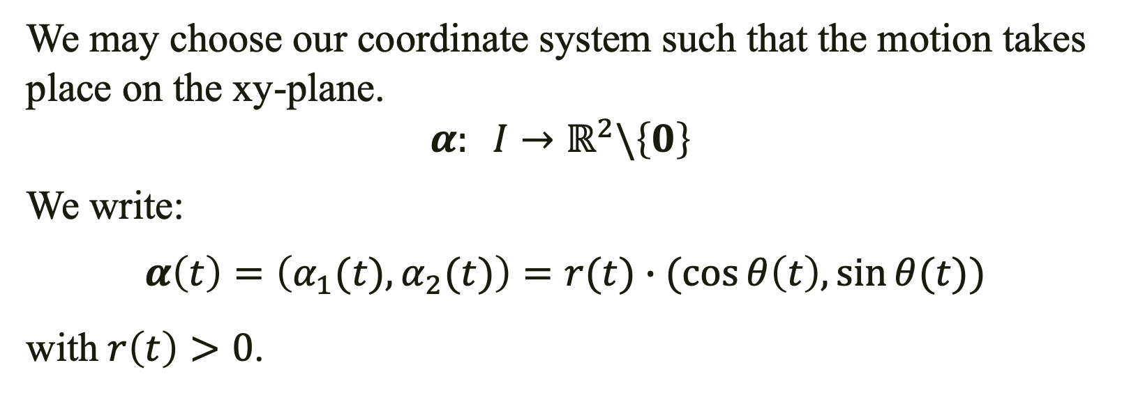
Planar Curves
We may choose our coordinate system such that the motion takes place on the xy-plane.
$$α: I→ℝ^{2}\backslash \left\{0\right\}$$
We write:
$$α\left(t\right)=\left(α_{1}(t),α_{2}(t)\right)=r(t)∙(\cos{θ\left(t\right),\sin{θ(t))}}$$
with$r\left(t\right)>0$.

Slide 11
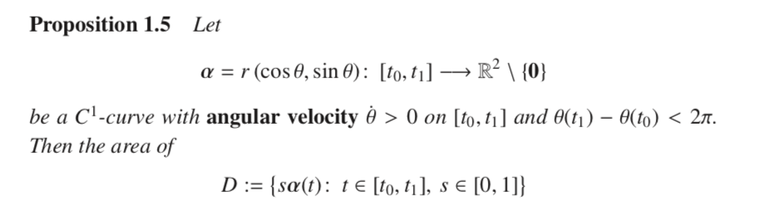
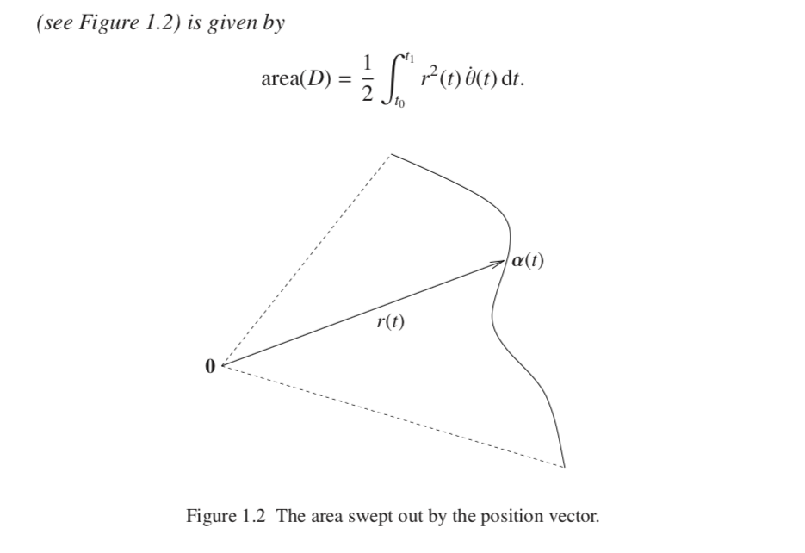
Area swept out by Position vector

Slide 12
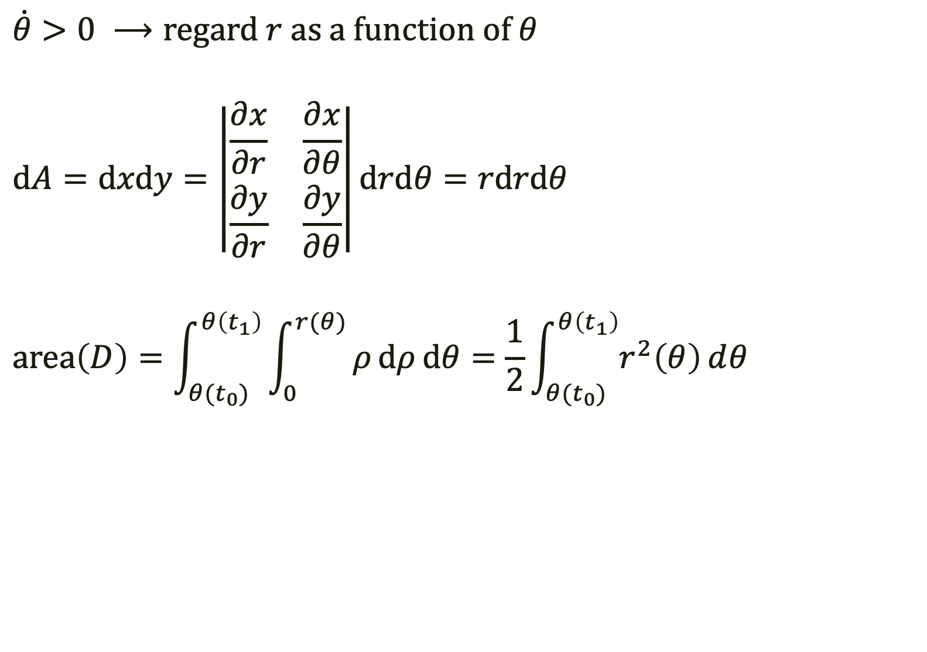

Area swept out by Position vector
$$\dot{θ}>0 ⟶\text{regard} r \text{as} \text{a} \text{function} \text{of} θ$$
$$dA=dxdy=\left|\begin{matrix}\frac{∂x}{∂r} & \frac{∂x}{∂θ} \\ \frac{∂y}{∂r} & \frac{∂y}{∂θ}\end{matrix}\right|drdθ=rdrdθ$$
$$area\left(D\right)=\int_{θ(t_{0})}^{θ\left(t_{1}\right)}{\int_{0}^{r(θ)}{ρⅆρⅆθ=\frac{1}{2}\int_{θ(t_{0})}^{θ\left(t_{1}\right)}{r^{2}\left(θ\right)ⅆθ}}}$$
$$r\left(t\right)≔r\left(θ\left(t\right)\right)$$
$$dθ=\dot{θ}dt$$

Slide 13
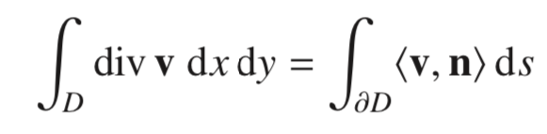
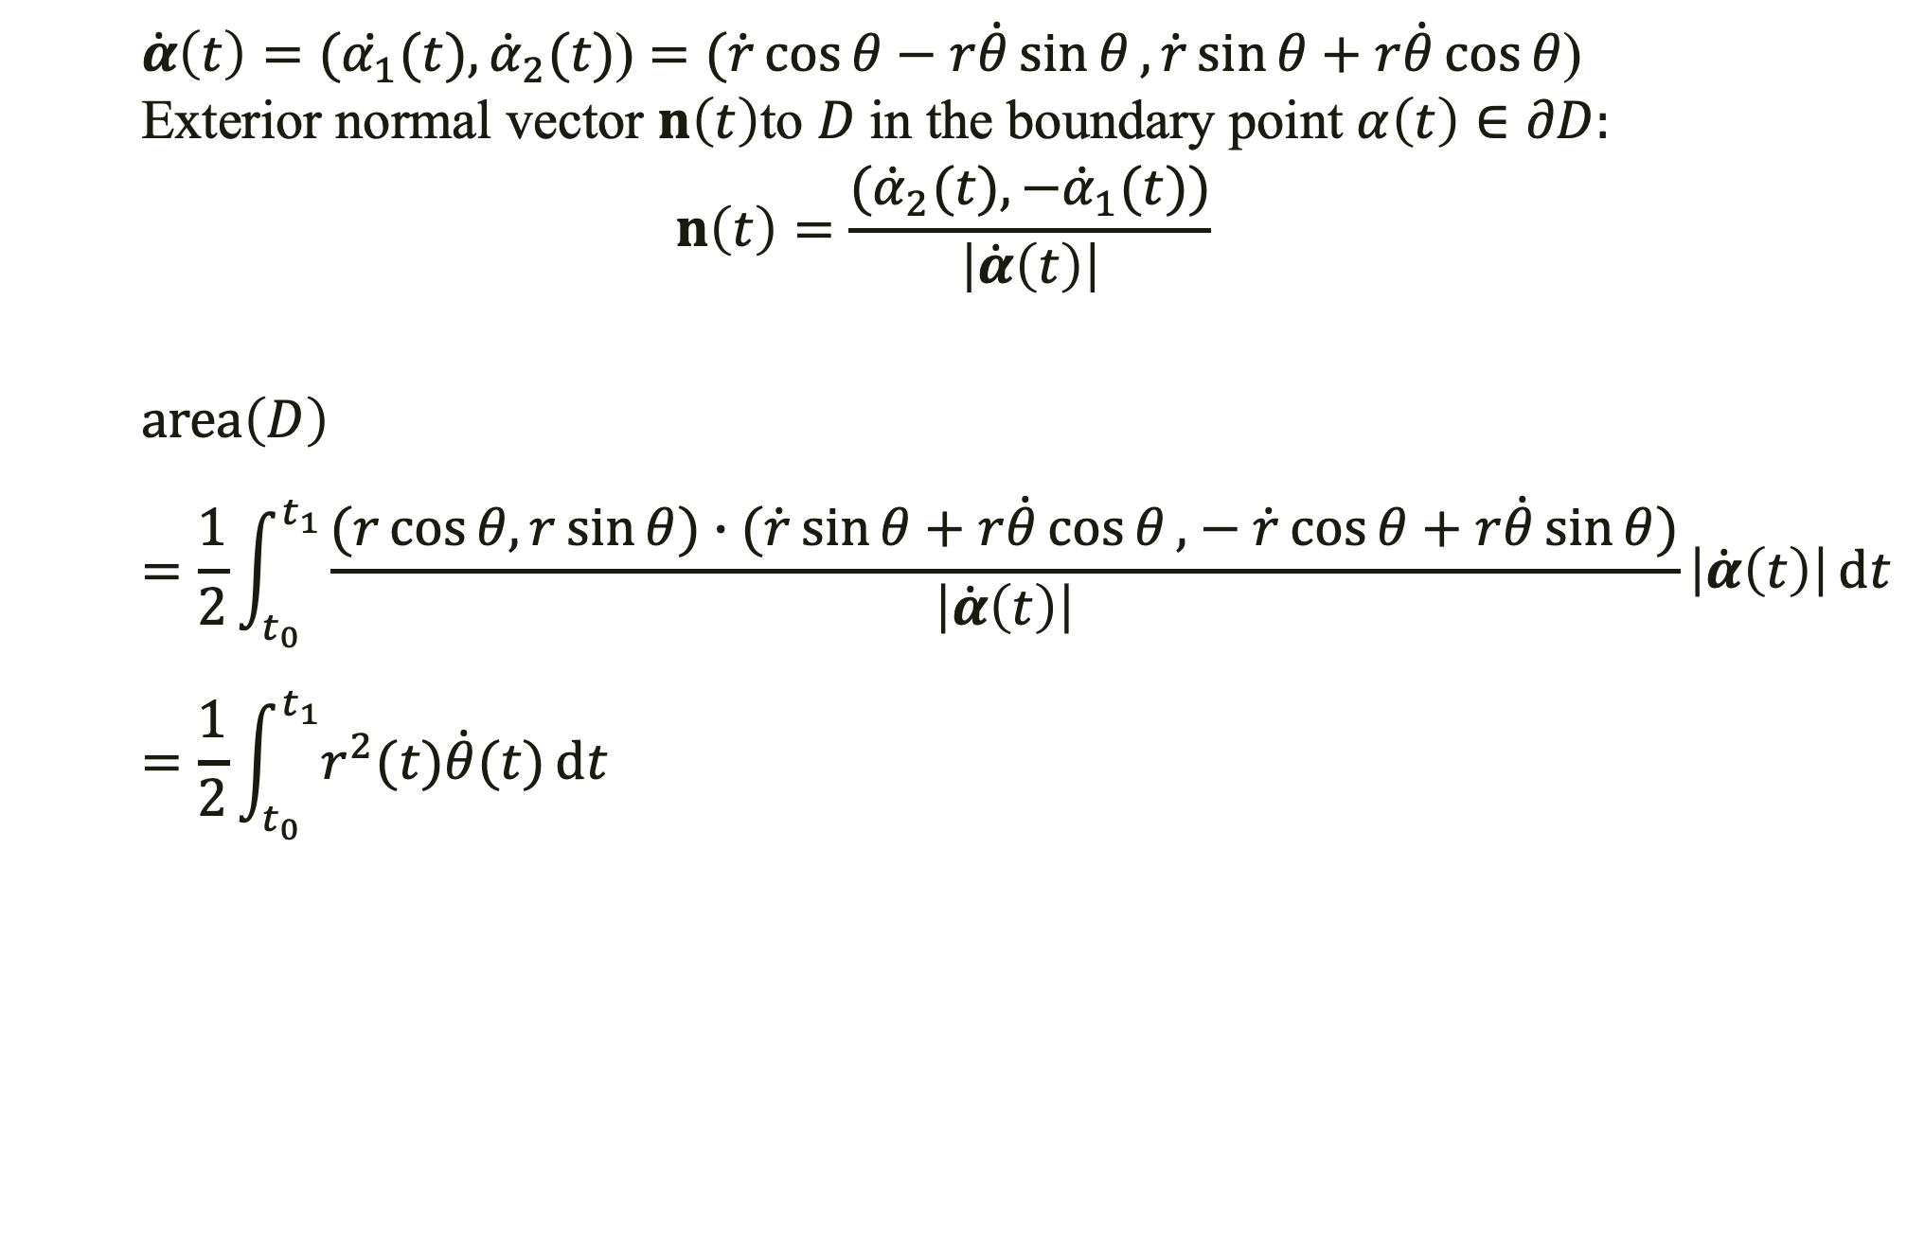
Area swept out by Position vector
$\dot{α}\left(t\right)=(\dot{α_{1}}(t),{\dot{α}}_{2}(t)$) $=(\dot{r}\cos{θ−r\dot{θ}\sin{θ},}\dot{r}\sin{θ+r\dot{θ}\cos{θ}}$)
$$\text{E}\text{xterior} \text{normal} \text{vector} n\left(t\right)\text{to} D \text{in} \text{the} \text{boundary} \text{point} α\left(t\right)∈∂D:$$
$$n\left(t\right)=\frac{({\dot{α}}_{2}(t),−{\dot{α}}_{1}(t))}{\left|\dot{α}\left(t\right)\right|}$$
$$area\left(D\right)$$
$$=\frac{1}{2}\int_{t_{0}}^{t_{1}}{\frac{(r\cos{θ,r\sin{θ)}}∙(\dot{r}\sin{θ+r\dot{θ}\cos{θ},}−\dot{r}\cos{θ+r\dot{θ}\sin{θ}})}{\left|\dot{α}\left(t\right)\right|}}\left|\dot{α}\left(t\right)\right|ⅆt$$
$$=\frac{1}{2}\int_{t_{0}}^{t_{1}}{r^{2}(t)\dot{θ}(t)ⅆt}$$

Slide 14
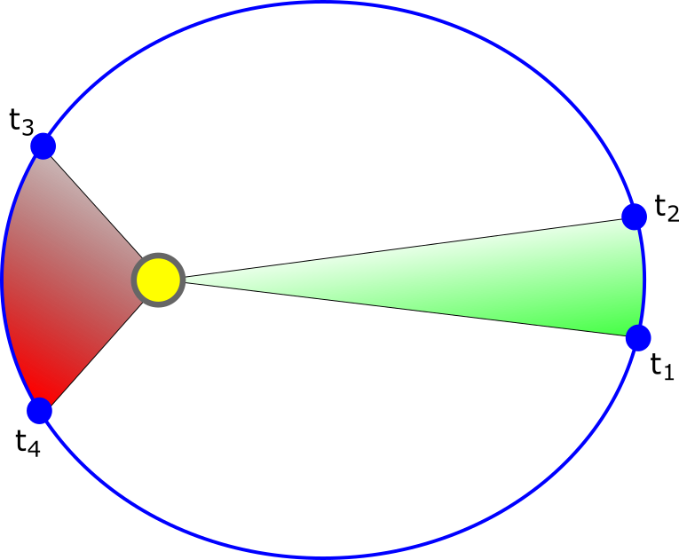

$$r\left(t\right)=r\left(t\right)⋅\left(\cos{θ\left(t\right),\sin{θ(t}}\right), 0)$$
$$\dot{r}\left(t\right)=(\dot{r}\cos{θ−r\dot{θ}\sin{θ},}\dot{r}\sin{θ+r\dot{θ}\cos{θ},0)}$$
Since angular momentum is constant,
$$c=r × \dot{r}=\left(0, 0, r^{2}\dot{θ}\right)$$
implies that ${\text{c}\text{ =} r}^{2}\dot{θ}$ is constant.
Then the area swept in [t₀, t₁] equals c(t₁-t₀)/2.
Remark: Converse also true

Slide 15
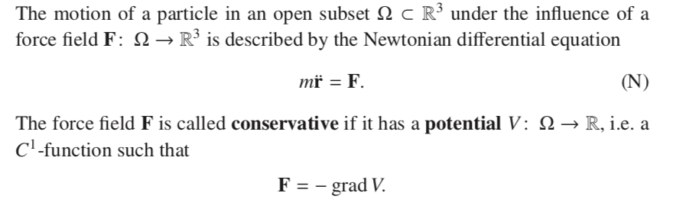
Conservation of energy

Slide 16
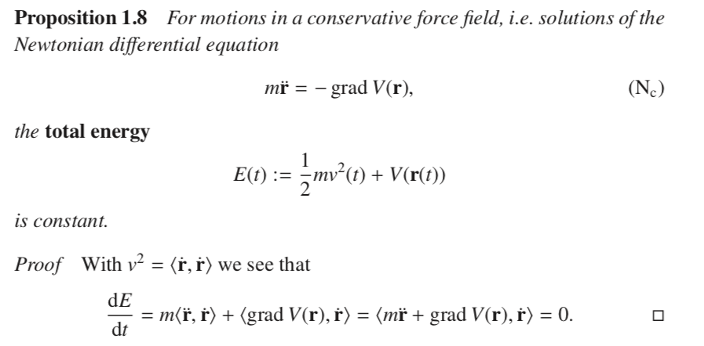
Conservation of energy
= 0

Slide 17
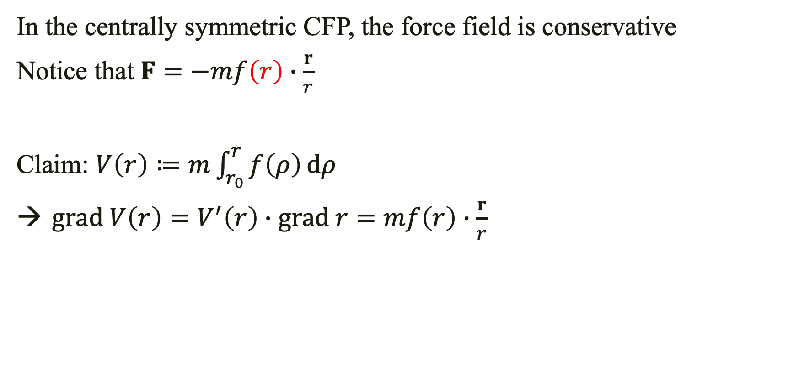
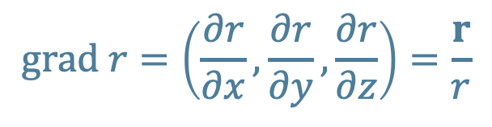
Conservation of energy
In the centrally symmetric CFP, the force field is conservative
Notice that $F=−mf\left(r\right)∙\frac{r}{r}$
Claim: $V\left(r\right)≔m\int_{r_{0}}^{r}{f\left(ρ\right)}ⅆρ$
$grad V\left(r\right)=V^{′}\left(r\right)∙grad r=mf\left(r\right)∙\frac{r}{r}$
$$grad r=\left(\frac{∂r}{∂x},\frac{∂r}{∂y},\frac{∂r}{∂z}\right)=\frac{r}{r}$$

Slide 18
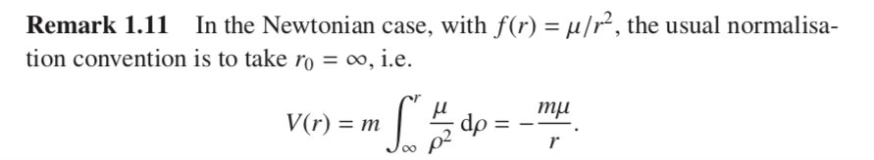
Conservation of energy

Slide 19
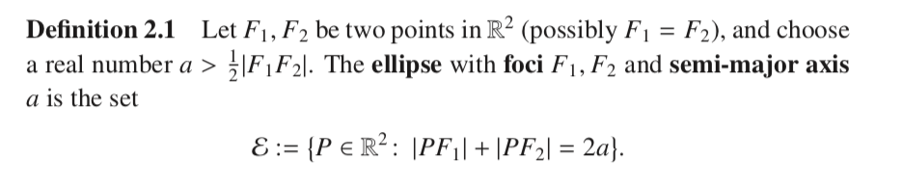
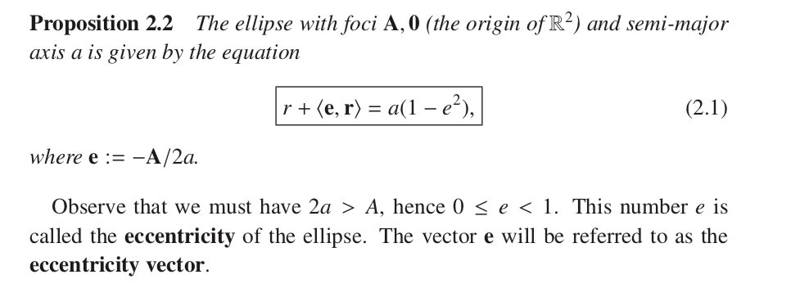
Conic Sections - Ellipses

Slide 20
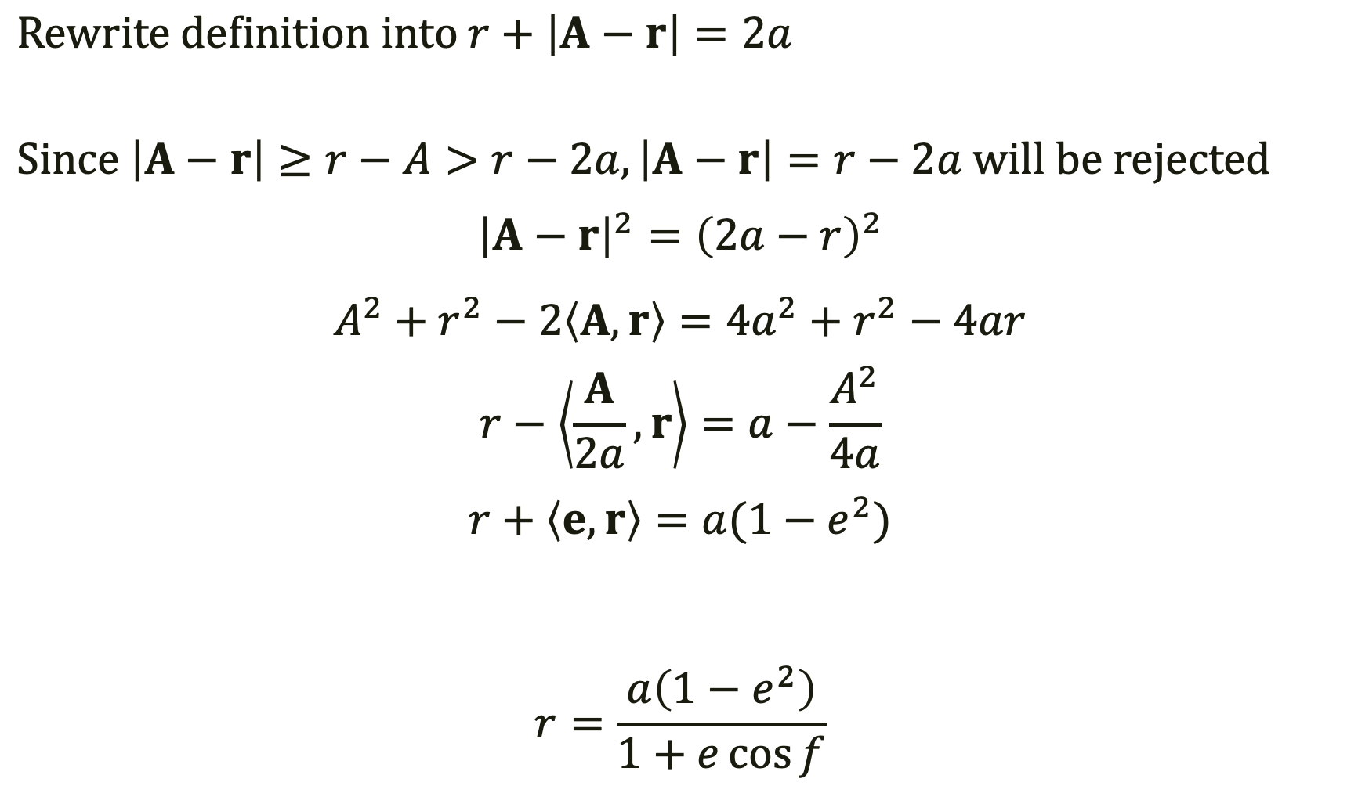
$$Rewrite definition into r+\left|A−r\right|=2a$$
$$Since \left|A−r\right|≥r−A>r−2a, \left|A−r\right|=r−2a will be rejected$$
$${\left|A−r\right|}^{2}={\left(2a−r\right)}^{2}$$
$$A^{2}+r^{2}−2\left\langle A,r\right\rangle =4a^{2}+r^{2}−4ar$$
$$r−\left\langle \frac{A}{2a},r\right\rangle =a−\frac{A^{2}}{4a}$$
$$r+\left\langle e,r\right\rangle =a(1−e^{2})$$
$$r=\frac{a\left(1−e^{2}\right)}{1+e\cos{f}}$$

Slide 21
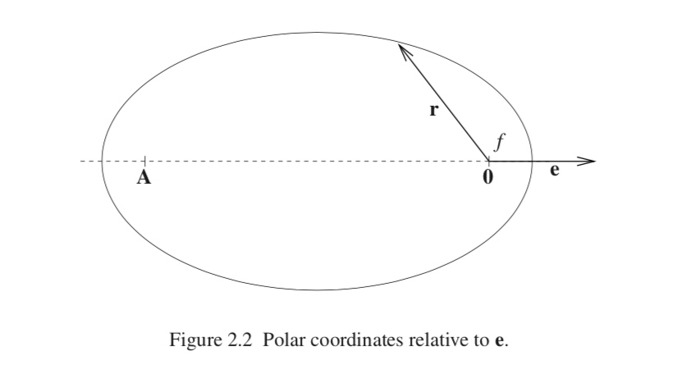

Slide 22
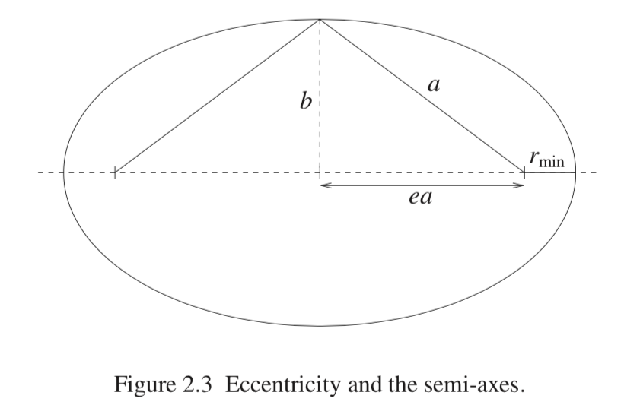
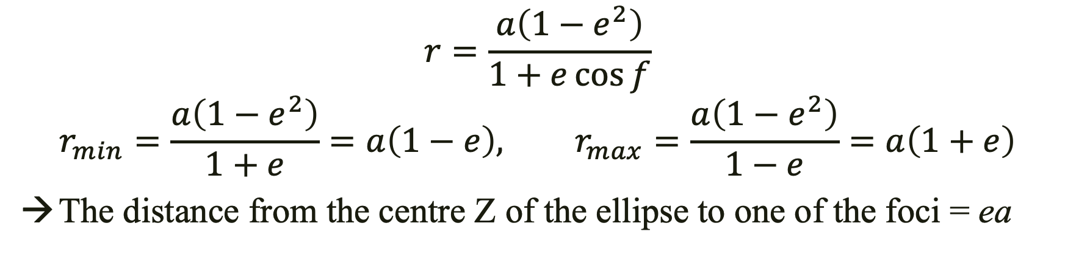
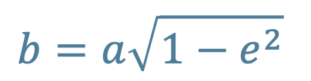
$$r=\frac{a\left(1−e^{2}\right)}{1+e\cos{f}}$$
$$r_{min}=\frac{a\left(1−e^{2}\right)}{1+e}=a\left(1−e\right), r_{max}=\frac{a\left(1−e^{2}\right)}{1−e}=a\left(1+e\right)$$
The distance from the centre Z of the ellipse to one of the foci = ea
$$b=a\sqrt{1−e^{2}}$$
Z

Slide 23
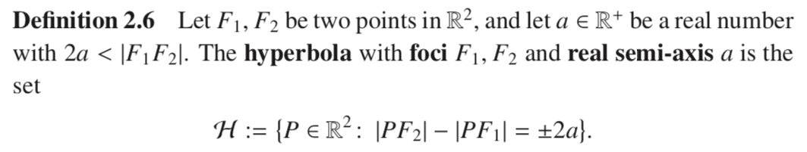
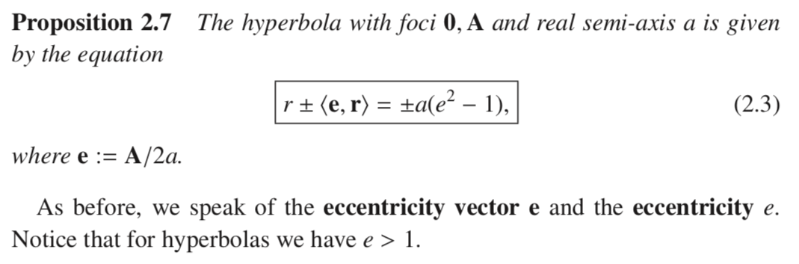
Conic Sections - Hyperbolas

Slide 24
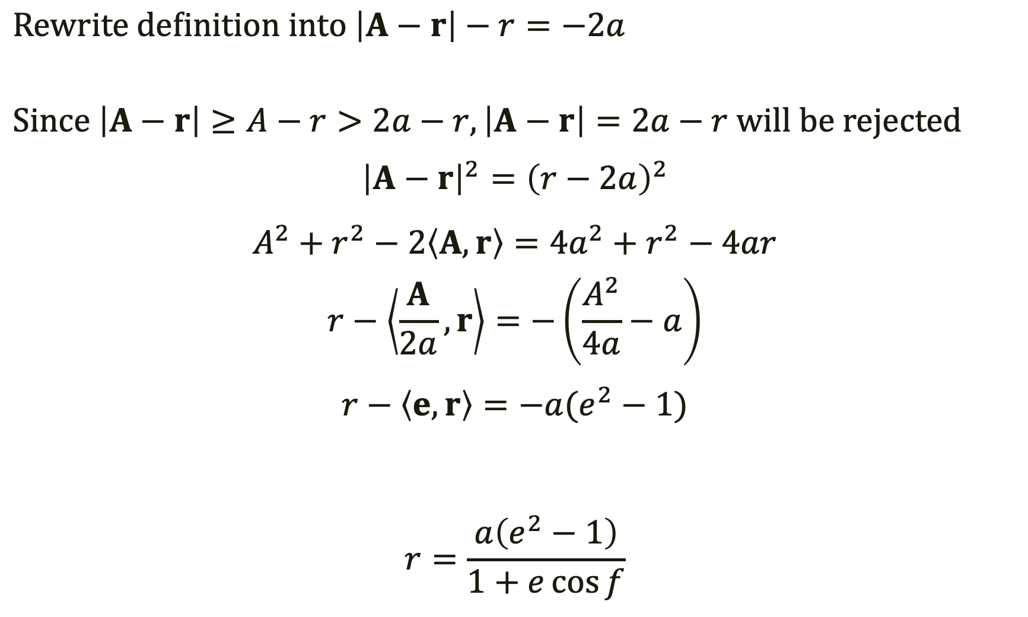
$$Rewrite definition into \left|A−r\right|−r=−2a$$
$$Since \left|A−r\right|≥A−r>2a−r, \left|A−r\right|=2a−r will be rejected$$
$${\left|A−r\right|}^{2}={\left(r−2a\right)}^{2}$$
$$A^{2}+r^{2}−2\left\langle A,r\right\rangle =4a^{2}+r^{2}−4ar$$
$$r−\left\langle \frac{A}{2a},r\right\rangle =−\left(\frac{A^{2}}{4a}−a\right)$$
$$r−\left\langle e,r\right\rangle =−a(e^{2}−1)$$
$$r=\frac{a\left(e^{2}−1\right)}{1+e\cos{f}}$$
|
|

Slide 25
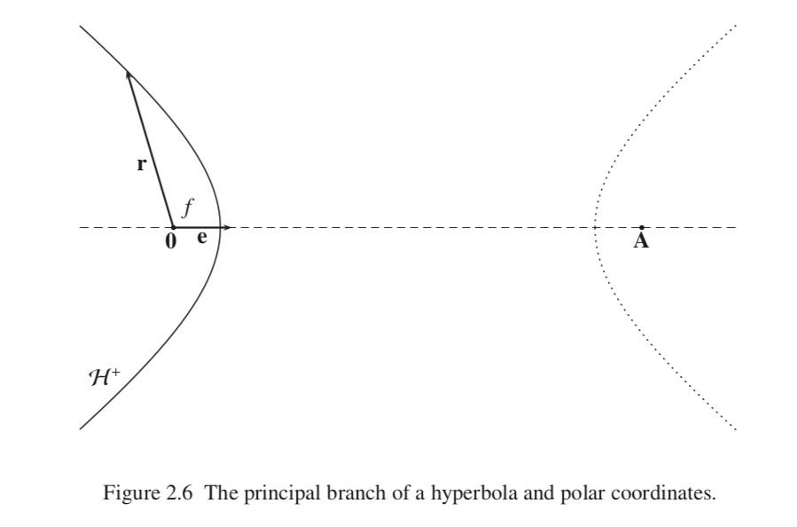

Slide 26
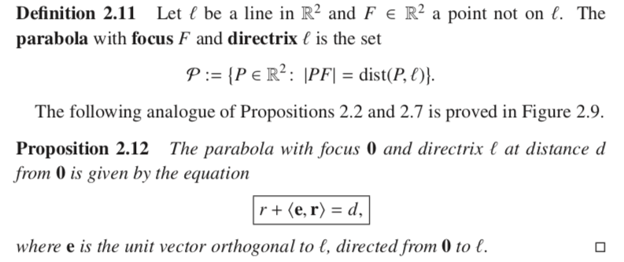
Conic Sections - Parabolas

Slide 27
